Slide 1
POC For Unified Electronic Payments Solution in USA
Project By:
Aishwary Shukla
Burhan Sadliwala
Ojas Thanawala
Rahatpal Bedi
Surendra Lama
Northeastern University, Boston, MA, USA

Slide 2
INTRODUCTION
Proof for Concept of Unified Payments System in USA (UPUSA).
Similar to world renowned payment system SADAD, currently used by Saudi Arabia and Bahrain.
Main focus on designing a unified payment system that works across multiple entities.
UPUSA works as a middleman between billers and banks, which can be accessed by the user.

Slide 3
CURRENT LIMITATIONS
Currently, no unified payment systems that works across multiple government and non-government entities.
Integration between banks and billers is complicated.
User has multiple accounts over different platforms, keeping track of which is hard.

Slide 4
MOTIVATION AND SIGNIFICANCE
Single integration across multiple entities.
Single point of access to pay and view bills from multiple entities.
Automate payments.

Slide 5
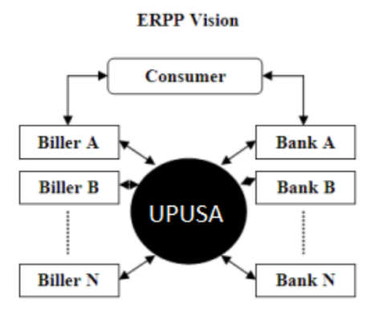
APPLICATION ARCHITECTURE
THE 3 MAIN ENTITIES :
BANK
BILLER
UPUSA

Slide 6
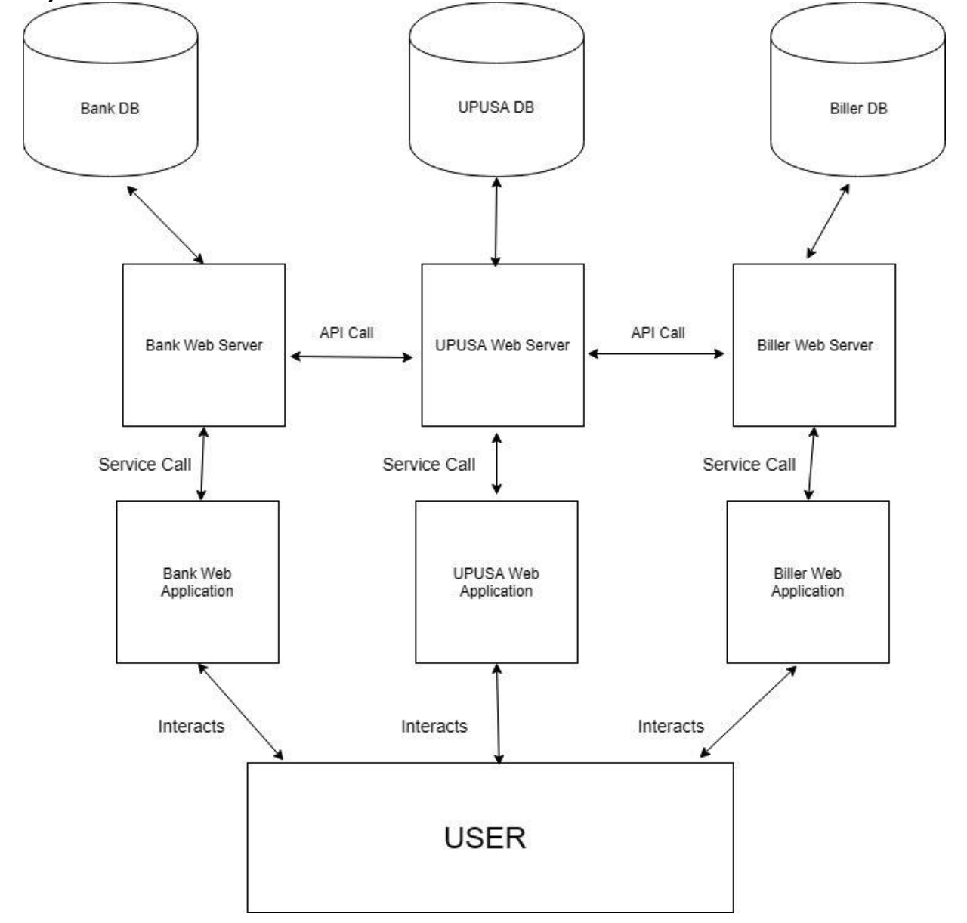
SYSTEM ARCHITECTURE
The user interacts with all the applications using their respective front-end web applications.
The Web-Application layer interacts with the Web Server using service calls.
The Web service interact with other entities using API calls.
The Web server also interacts with the DB.

Slide 7

ENTITY - BANK
This entity includes all the financial payment institutions.
Each institution must have at least one user, while the user can hold or create accounts in multiple payment institutions.
This entity only interacts with the central system (UPUSA).
Example: Bank of America.

Slide 8


ENTITY - BILLER
This entity includes all the various types of governmental and non-governmental biller organizations.
These can include gas bill, electricity bill, flights and many more.
The biller generates the bill on the UPUSA ID of a given user to uniquely identify the user and sends it to the central system.
Example: Eversourse Energy, Atom movies.

Slide 9

ENTITY - UPUSA
This entity is the centralized system which stores all the information of a user.
This entity directly communicates with the Biller and Bank.
Each bill from a biller is stored here.
Similarly, each payment of the bill is sent from the payment institution to the biller’s bank via UPUSA.

Slide 10
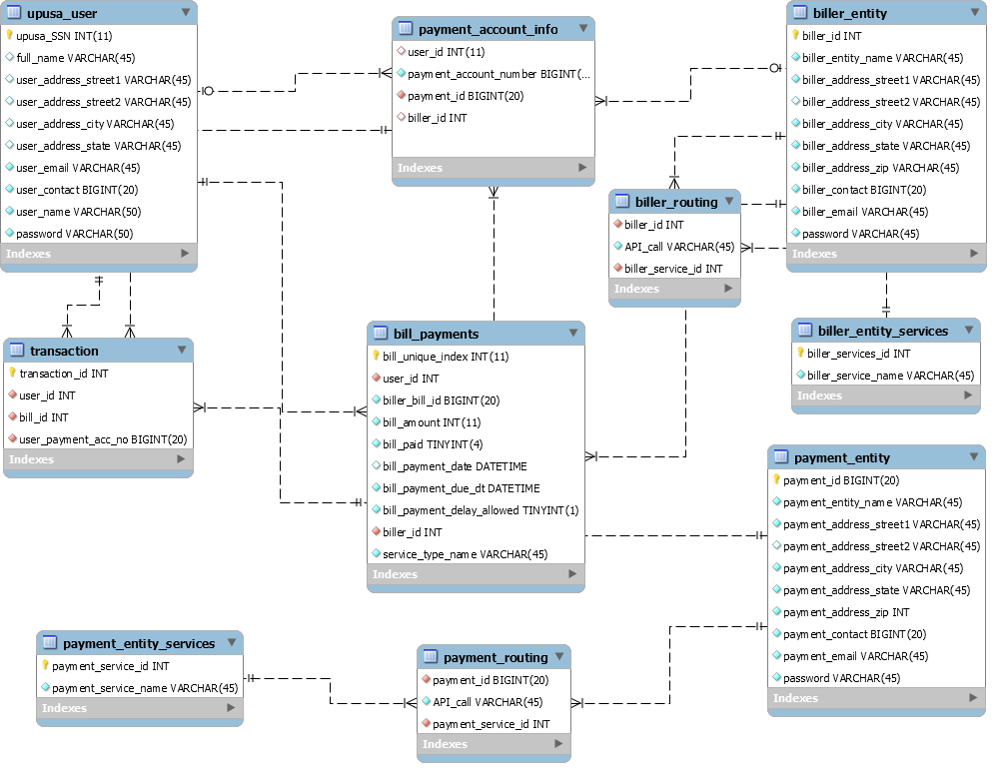
ER diagrams: UPUSA

Slide 11
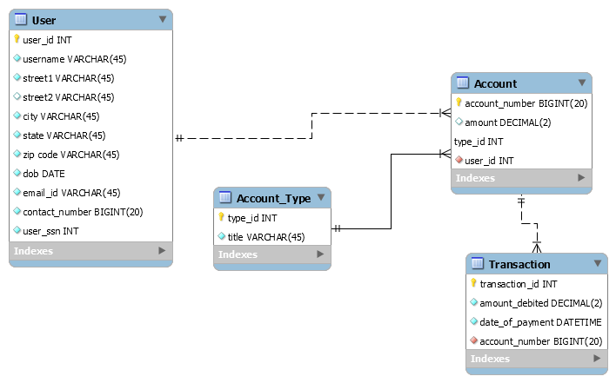
ER diagram: Payment Institution

Slide 12
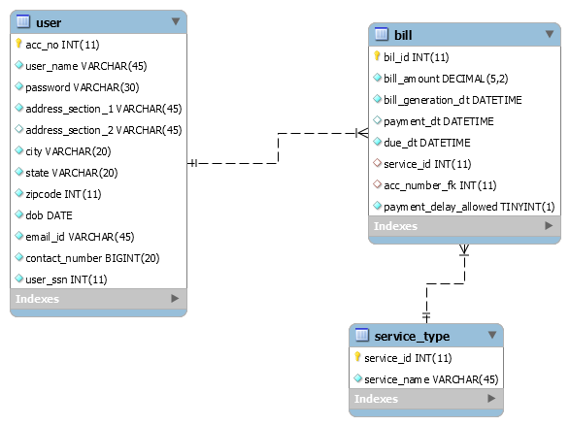
ER diagram: Biller

Slide 13
USE CASES
One ID – Every Utility!
Consolidated view of all the bills.
Seamless Integration of all entities.
Automated payments.

Slide 14
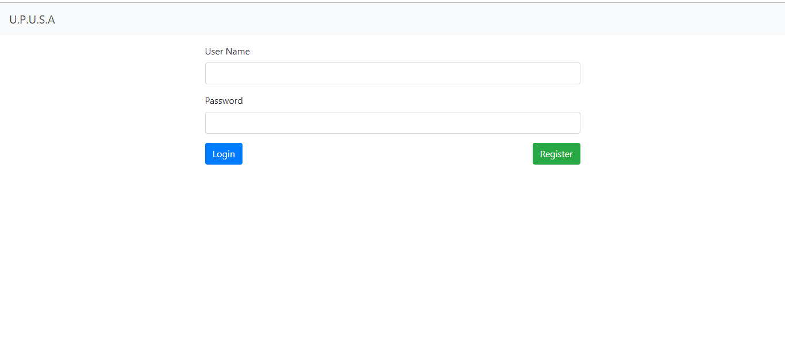
UI – Login Screen

Slide 15
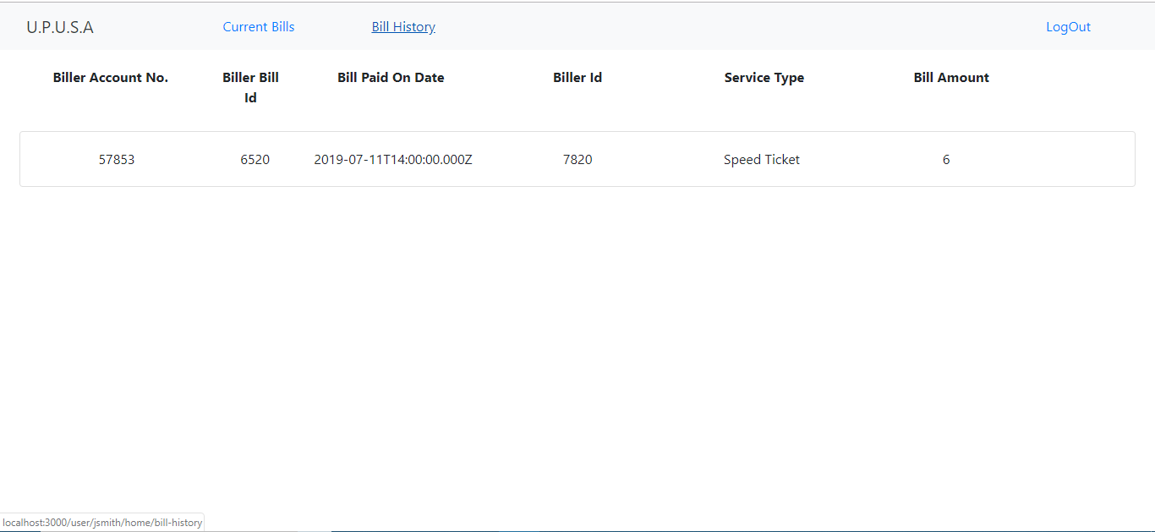
UI – Bill History

Slide 16
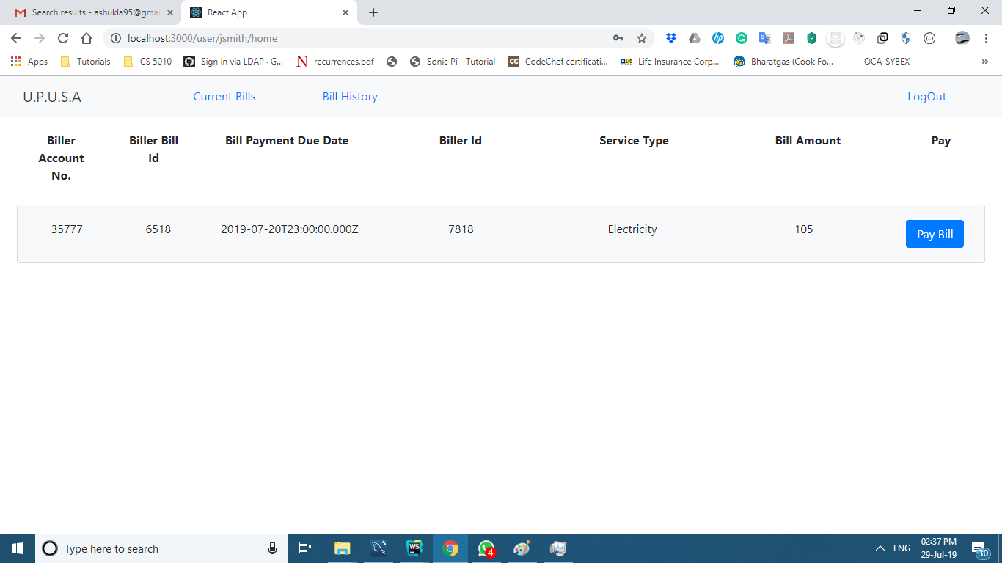
UI – Current Bills

Slide 17
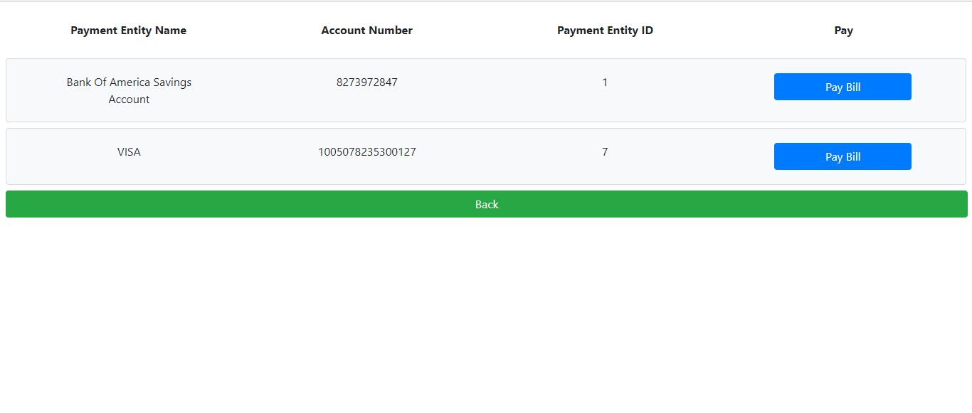
UI – Payment Screen

Slide 18
DEMO

Slide 19
FUTURE SCOPE
Encrypt and decrypt the UPUSA ID of the user.
Addition of more analytic functionalities for the user.
Handle payments when funds are low.
Addition of entities like Insurances.

Slide 20
CONCLUSION

Slide 21
THANK YOU
QUESTIONS?

